Slide 1

We’re STEAMED! A call for balancing technical instruction and disciplinary content in the digital humanities Christopher Church Katherine Hepworth
Notes:
Today our students consume (and produce) the majority of their information digitally. And yet, in most history classes, they are evaluated using the analog essay as it was brought to us by Michel de Montaigne nearly 500 years ago. While essay-writing is no-doubt essential for teaching critical thinking and evidence-based argumentation, communication technologies of the sixteenth century are not best suited to reach students of the twenty-first. While many now recognize the utility of digital projects in the history classroom, many more find only frustration in implementing them.
Preconceived notions about what our students bring to the classroom, I would argue, are at the root of that frustration.
Conveying the lessons learned from teaching an undergraduate digital history methodology course at the University of Nevada, Reno, I’ll discus the opportunities and avoidable pitfalls of employing an historical pedagogy rooted in digitized media.

Slide 2
Overview

Slide 3
Overview Digital Natives?

Slide 4
Overview Digital Natives? STEAM

Slide 5
Overview Digital Natives? STEAM Two Course Examples

Slide 6
Overview Digital Natives? STEAM Two Course Examples Lessons Learned

Slide 7
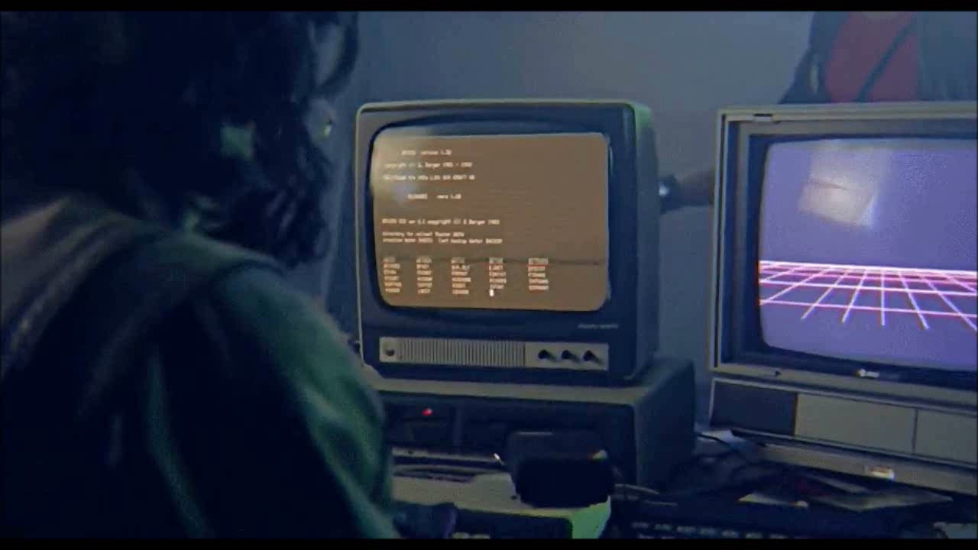

Slide 8

Myth of the Digital Native
Notes:
Before I begin discussing the course that I teach, I’d like to give you a sense of the students and what they bring (and don’t bring) to the classroom with them.
According to Neil Selwyn, from the Institute of Education at the University of London, the notion that young people and children are inherently more confident and capable in computerized that is, that they are “experts” or somehow native to the digital world—has held currency since the 1970s, long before Marc Prensky coined the term “digital native” in 2001. This idea has only gained more momentum over the years, shaping how we treat the next generation, both culturally and pedagogically. [1]
To some extent, we are all touched by the idea that since children were born into a world with computers, and since they have interacted with technology since essentially birth, they have necessarily become…
[1] Selwyn, Neil. "The digital native: myth and reality". Selwyn, Neil (2009) The Digital Native: Myth and Reality. ASLIB Proceedings, 61 (4). Pp. 364-379. ISSN 0001-253X

Slide 9
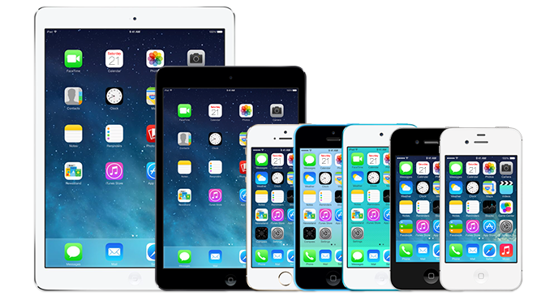
Notes:
However, the computing devices that students engage with are primarily content-consumption devices, used for watching movies or playing games, all at the tip of a finger. Touch an app, and the device handles the rest.
So children and students today do not use computing technology to create, but rather to consume content, and they do not merely achieve fluency with a device via osmosis.
To use an analogy: riding in a car does not make one able to drive one by dint of the hours ridden (if that were true, I could turn over my keys to my 6-year-old). And to follow the analogy, driving a car does not in-and-of itself qualify one to be a mechanic.
As Selywn (2009) states, “young people’s engagements with digital technologies are varied and often unspectacular – in stark contrast to popular portrayals of the digital native.” And he identifies what he calls “a misplaced technological and biological determinism that underpins current portrayals of children, young people and digital technology.”

Slide 10
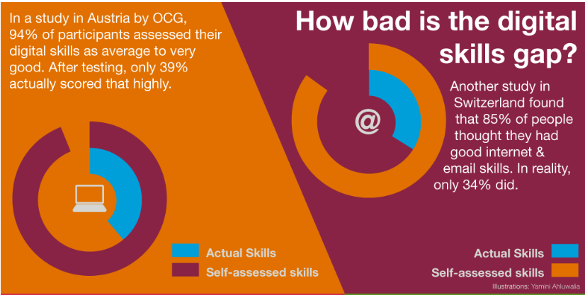

http://ecdl.org/policy-publications/digital-native-fallacy
Notes:
Further work by the European Computer Driving Licence organization (or ECDL) has further highlighted the dramatic gap between cultural perception and reality. And in this case, individuals themselves, as a result of this myth, have a grossly overestimated perception of their own technological ability.
As you can see, while 94% of survey participants in Austria felt they had average to very good digital skills, only 39% actually demonstrated such a skill level. Results were similar in Switzerland.

Slide 11
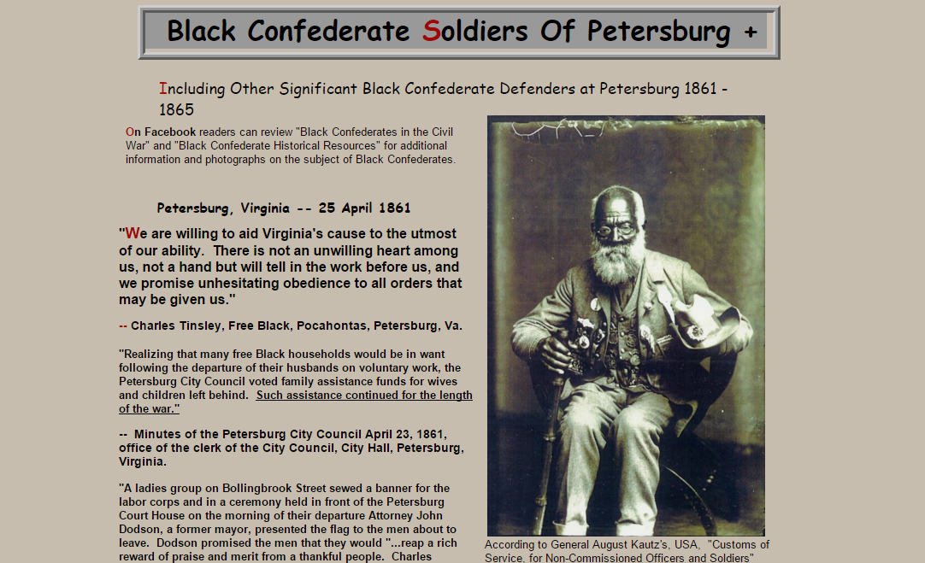
Notes:
And this is a real problem, because the internet truly represents the wild, wild west. Anyone can and does post material, of whatever quality, to the worldwide web.
One of the most pernicious myths resulting from this is that of the Black Confederate soldier, which despite being statistically insignificant during the Civil War has now come to represent a legitimation for neo-Confederates across the web, from social media to white supremacist forums.

Slide 12
Teaching Model: STEAM

Slide 13
Teaching Model: STEAM Science

Slide 14
Teaching Model: STEAM Science Technology

Slide 15
Teaching Model: STEAM Science Technology Education

Slide 16
Teaching Model: STEAM Science Technology Education Art

Slide 17
Teaching Model: STEAM Started in 2006

Slide 18
Teaching Model: STEAM Started in 2006 Design incorporated in 2010

Slide 19
Teaching Model: STEAM Science Technology Education Art + Design

Slide 20
Two Courses

Slide 21
Two Courses HIST300a Digitizing History

Slide 22
Two Courses HIST300a Digitizing History JOUR/HIST308 Web Design for Social Engagement

Slide 23
Two Courses Project-based Service learning

Slide 24
Two Courses Project-based

Slide 25
Two Courses Project-based Service learning

Slide 26
Two Courses Project-based Service learning Interdisciplinary domain instruction

Slide 27
Two Courses Project-based Service learning Interdisciplinary domain instruction Domain instruction + technical instruction

Slide 28
Two Courses Project-based Service learning Interdisciplinary domain instruction Domain instruction + technical instruction = Critical Digital Humanities

Slide 29
Digitizing History

Slide 30
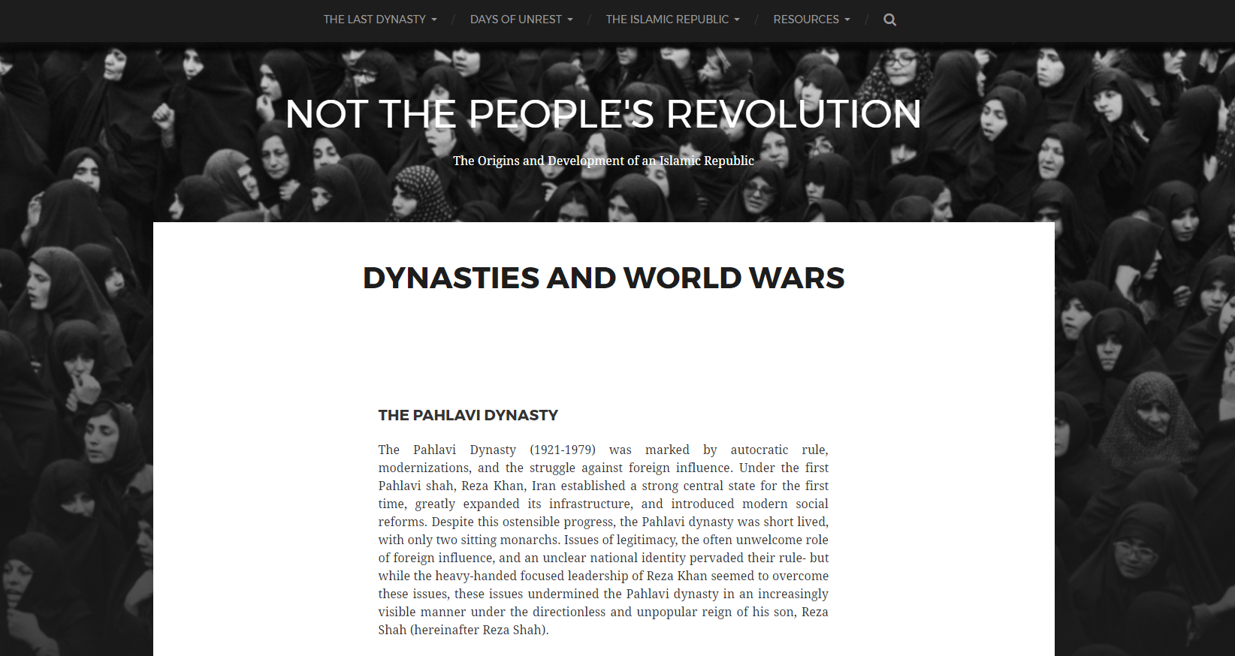
http://digitalhistory.acs.unr.edu/hist300a/sp2016/iranianrevolution/
Notes:
Now that I’ve explained to you the motivations and research underpinning the class, I’d like to close with an example of student output.
This student examined the role of popular perception in the 1979 Islamic Revolution in Iran, arguing that frustration with autocracy and a hope for a better future led many to support a regime that would tragically bring neither.

Slide 31
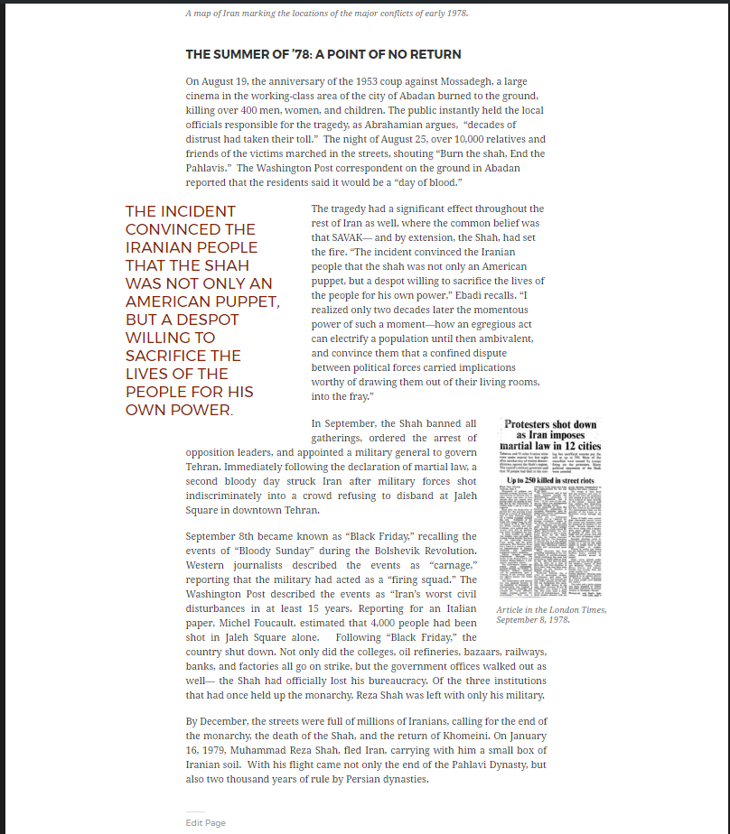
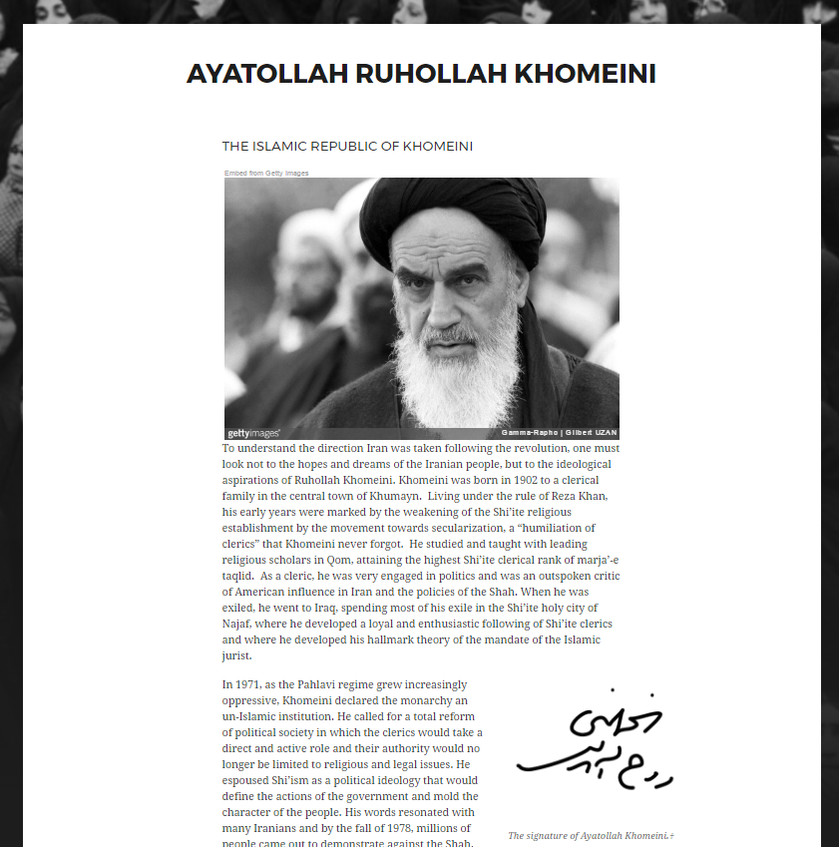
Notes:
She integrated primary source materials alongside her textual narrative, giving thought to page layout, media placement, and stylistics.
Since I’m short on time, I wanted to show you a brief clip from the introductory video she made for her project (the first 90 seconds of her 5-minute video).

Slide 32


Slide 33
Web Design for Social Engagement

Slide 34


Slide 35


Slide 36
Lessons Learned

Slide 37
Lessons Learned Scaffolding becomes more critical

Slide 38
Lessons Learned Scaffolding becomes more critical Quadruple instruction preparation time

Slide 39
Lessons Learned Scaffolding becomes more critical Quadruple instruction preparation time Double in-classroom tech instruction time

Slide 40
Lessons Learned Scaffolding becomes more critical Quadruple instruction preparation time Double in-classroom tech instruction time Halve your domain knowledge instruction time

Slide 41
Lessons Learned Scaffolding becomes more critical Quadruple instruction preparation time Double in-classroom tech instruction time Halve your domain knowledge instruction Incorporating tech instruction amplifies domain instructions

Slide 42

Thank you
Notes:
I hope that I have shown you three things:
That students just get technology no more so than they just get history. That the widespread assumption that students are digital natives for whom technology comes second-nature harms more than it helps.
Consequently, that digital literacy instruction in the content area requires far more time than it may seem at first glance, and that flipping the classroom is precisely the way to give students the hands-on instruction hey need.
And finally, that students benefit from digital project-based instruction precisely because it teaches critical thinking alongside the digital literacy skills so essential to our modern world. And that they can create fantastic projects under these conditions!

